Slide 1
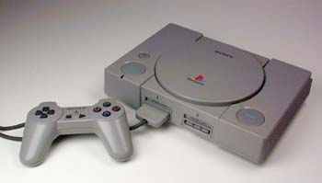
playstation

Slide 2
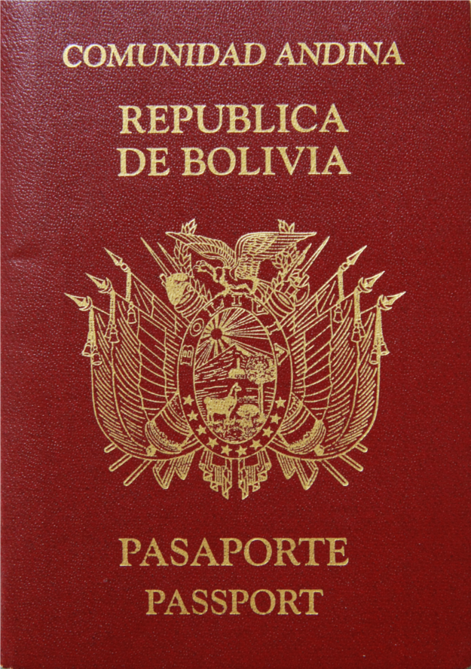
passport

Slide 3
spade

Slide 4
pen knife

Slide 5
television

Slide 6
lighter

Slide 7
laptop

Slide 8
tent

Slide 9
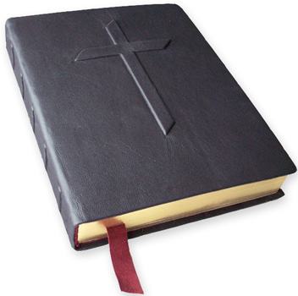
Bible Qu’ran

Slide 10
pet

Slide 11
sleeping bag

Slide 12
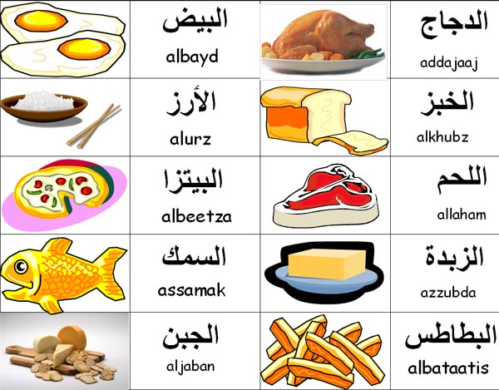
food

